Slide 1

4th Semester Mini Project
Session : 2021 - 22
Group Chat Web Application
Made By : Mohit Singh Dhami

Slide 2
Features of Group Chat Web Application
Real-Time Chat: Chats done in this App are real-time and Requires Decent Internet Connection.
File Sharing: We can Share any Type of File (Images, GIFs, Audio, Video, Documents etc ) in this Application.
No Installation: We can use this App without installing any additional Software,
Just a latest browser is sufficient to use this application.
No Login: We can start chatting without signing up or Logging to any Account which Protects your Identity and makes you Anonymous.

Slide 3
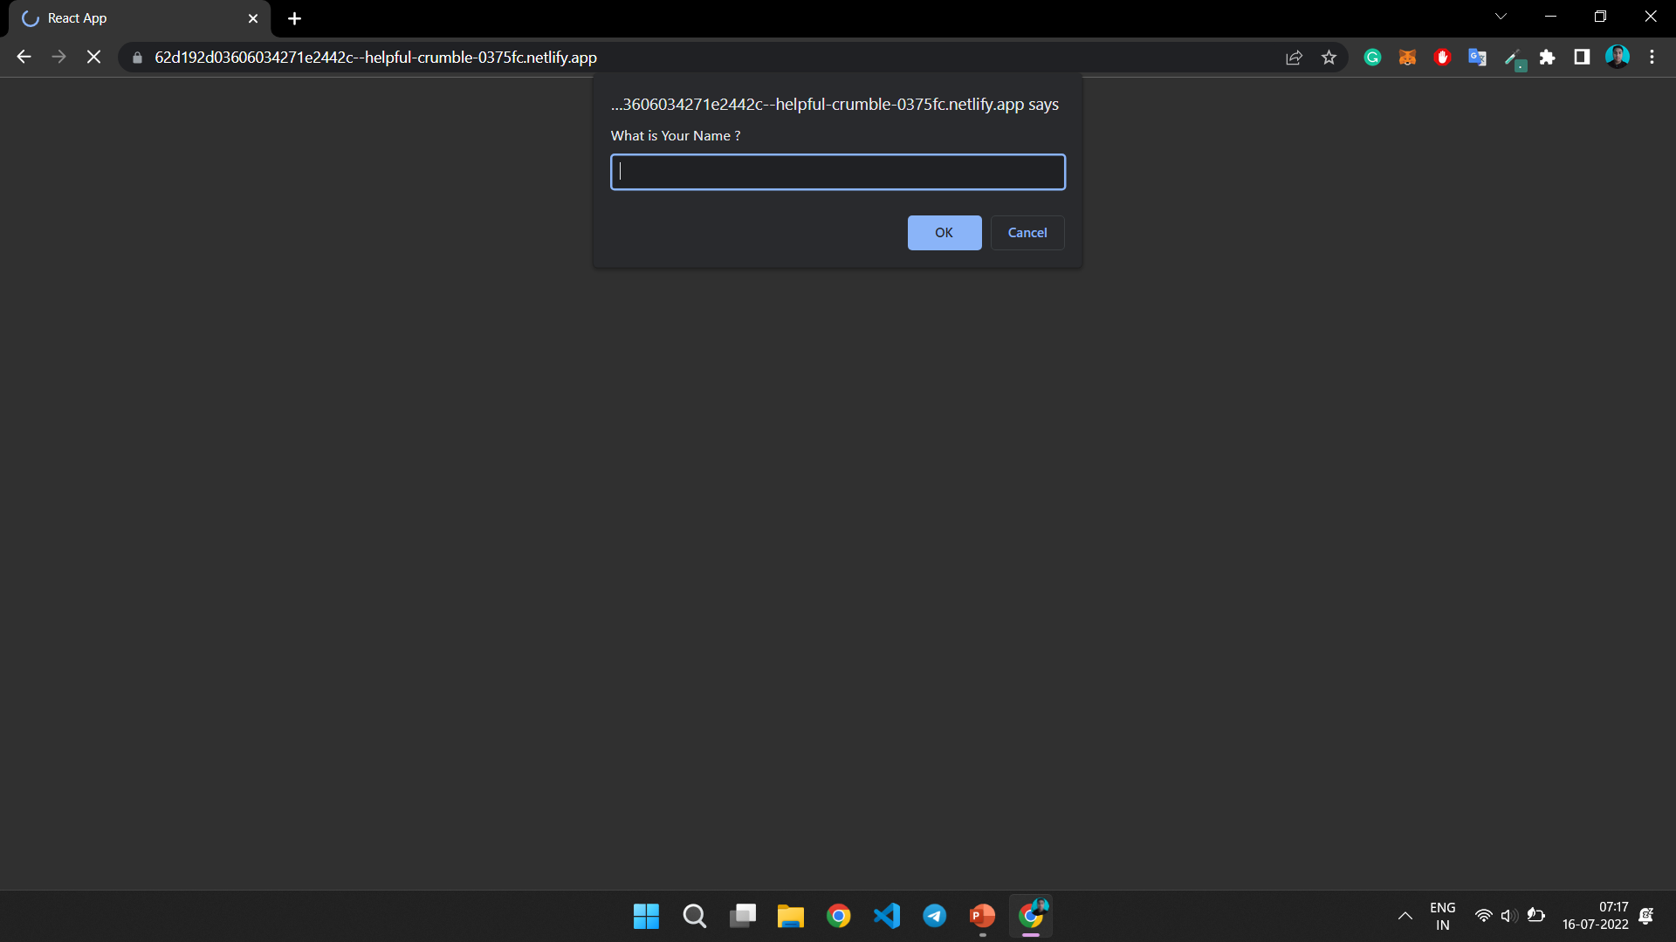
Project Explanation
When The Application is Launched, we will see a Prompt Saying :
What is Your Name ?
We have to Provide Some Name which will be used in App to Differentiate Users and show Chats Properly.
Output: Prompt - Application Launch

Slide 4
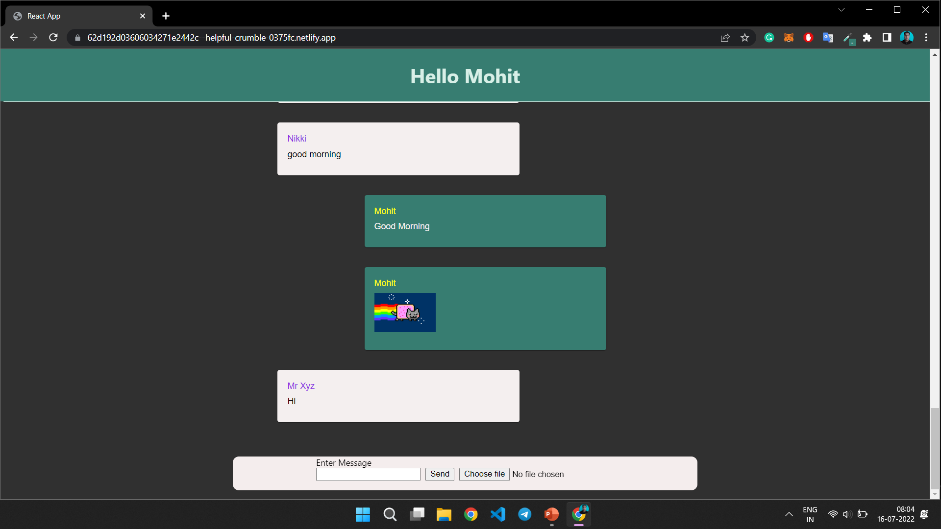
Project Explanation
After Entering Name in the prompt, the main app will be shown where Chats can be Seen.
At the Bottom we get Chat Box from where Messages and Files can be Send and Shared with Everyone on the Group.
Output: Application Interface

Slide 5
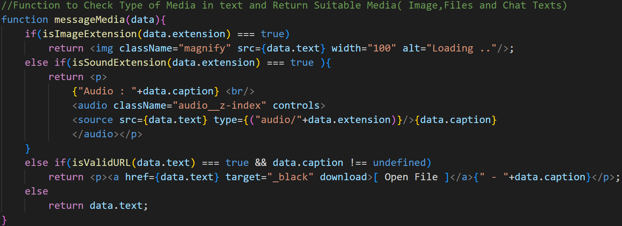
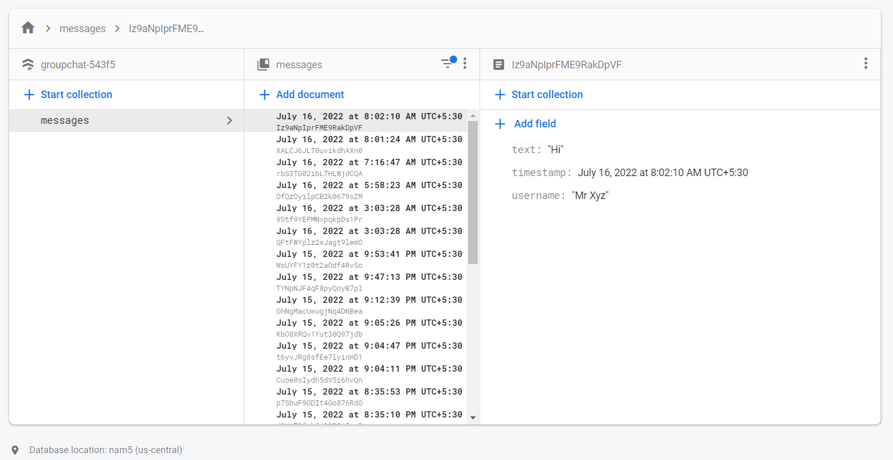
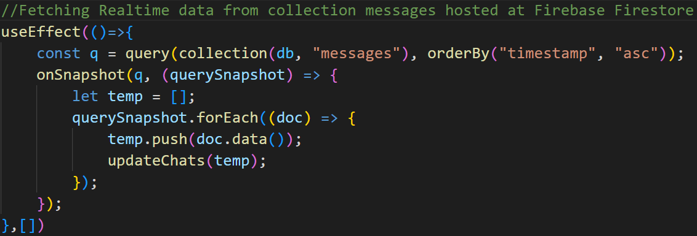
Project Explanation
Languages and Services used are -
Language: HTML, CSS, JavaScript
Library: React.js, Material UI
Database: Firebase Firestore Database
File Hosting: upload.io
Code to Show Media Files According to Their Format
Firebase Firestore Database
Code to Fetch Chats From Database

Slide 6


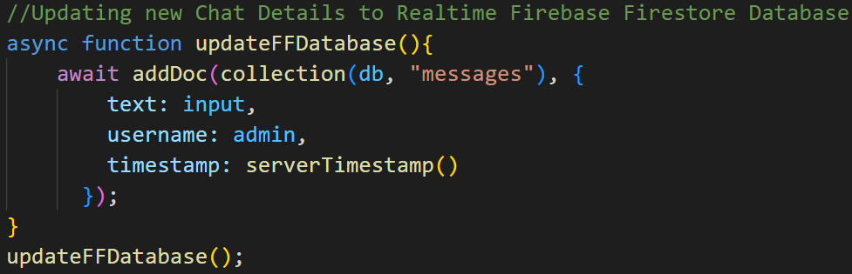
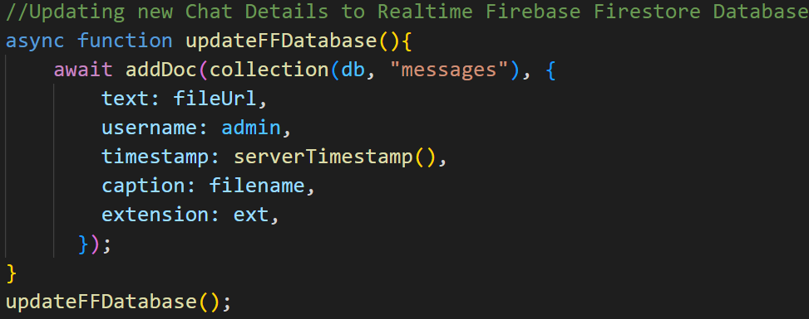
Project Explanation
* Chat Text is Saved to DB
User Type Message and Click Send / Press Enter
Returns URL of the File After Successful
Hosting
* URL is saved to DB
Choose File
* File is Send to upload.io
Flow of Data From User End to Database
Updating DB ( Text Chat )
Updating DB ( Files )

Slide 7
Thank You

